Slide 1


Lung CLQ
&
MM Pancreas
Production Statistics
By Ravindra
PRIVATE & CONFIDENTIAL ONLY FOR VASTA GLOBAL EMPLOYEES

Slide 2

Contents
1.Projection
3.Weekly Production count
4.MDA wise Production Count
5.Incentive Count
6.Accuracy rate
2.Production Count
PRIVATE & CONFIDENTIAL ONLY FOR VASTA GLOBAL EMPLOYEES

Slide 3
Projection
Lung CLQ
MM Pancreas
PRIVATE & CONFIDENTIAL ONLY FOR VASTA GLOBAL EMPLOYEES

Slide 4
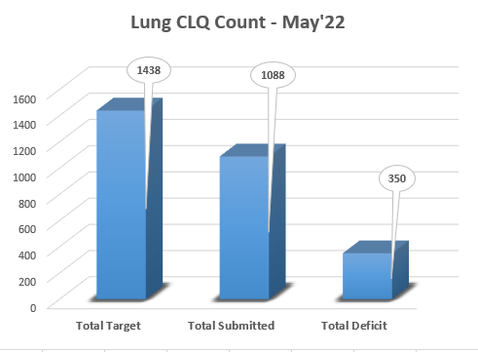
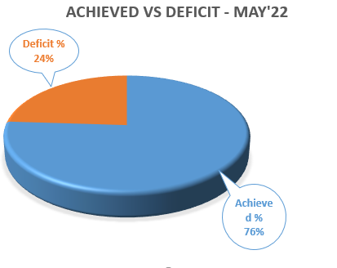
Production Count
Lung CLQ
PRIVATE & CONFIDENTIAL ONLY FOR VASTA GLOBAL EMPLOYEES

Slide 5
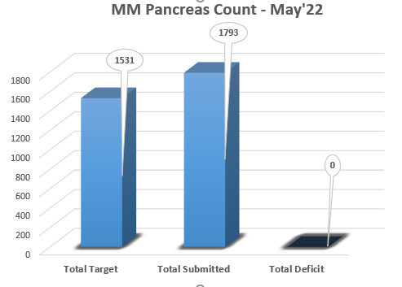
Production Count
MM
Pancreas
PRIVATE & CONFIDENTIAL ONLY FOR VASTA GLOBAL EMPLOYEES

Slide 6
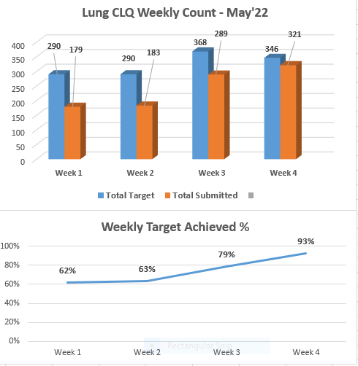

Weekly Production Count

Slide 7
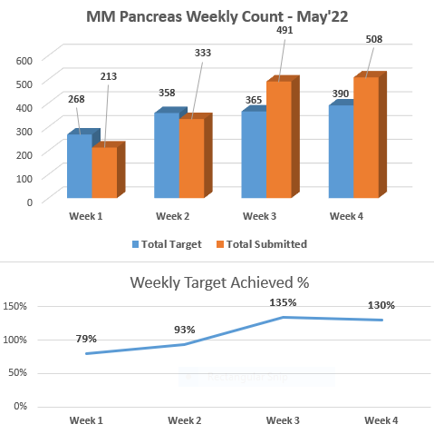

Weekly Production Count

Slide 8
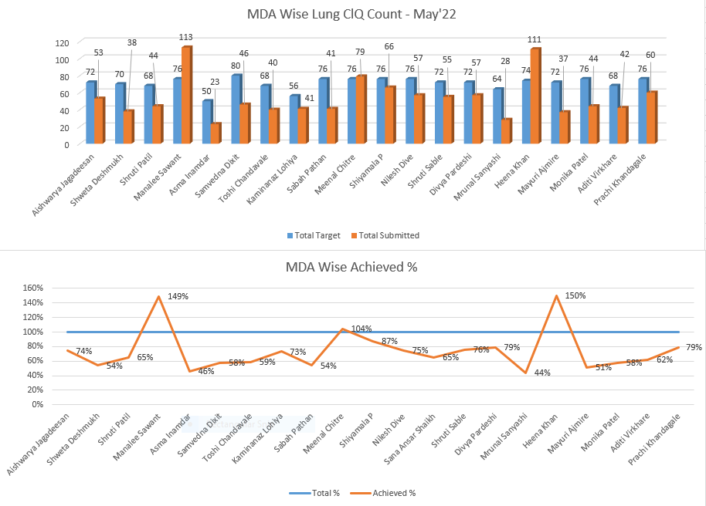


Slide 9
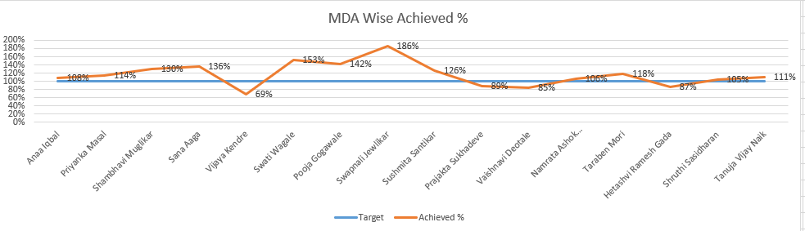
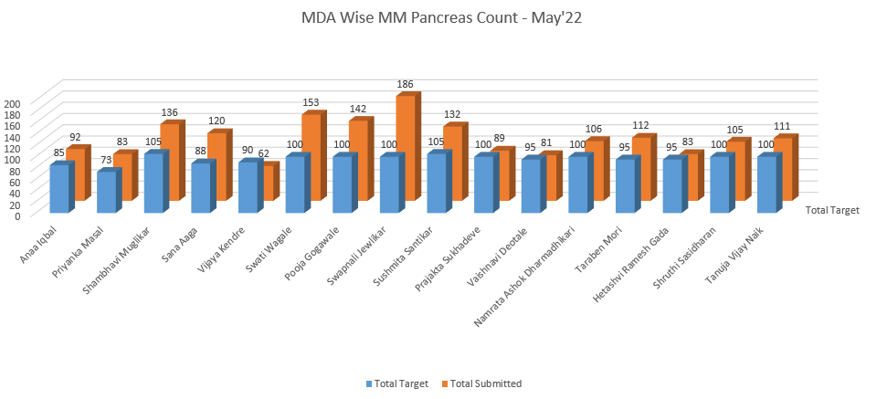

Slide 10
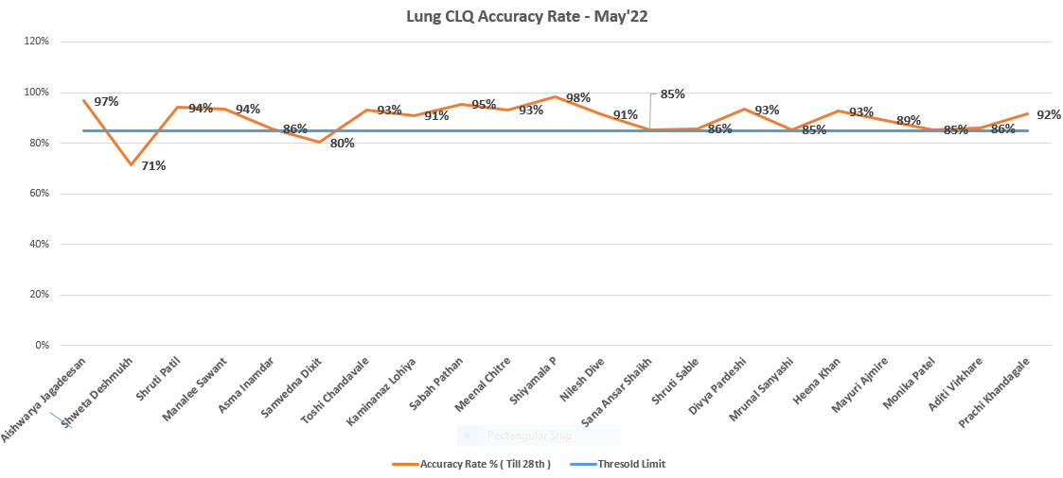
Accuracy Rate
Lung CLQ

Slide 11
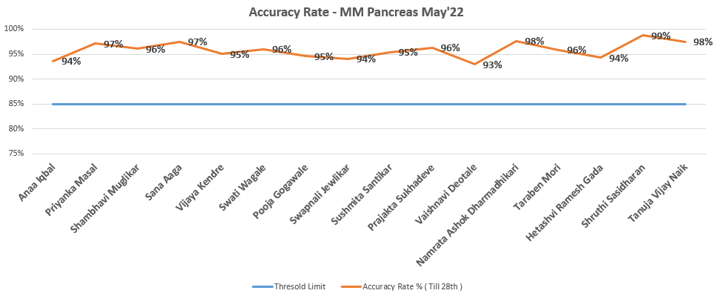
Accuracy Rate
MM Pancreas

Slide 12
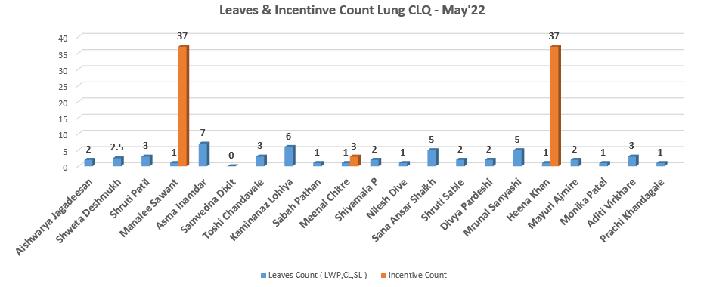
Leave & Incentive Count
Lung CLQ

Slide 13
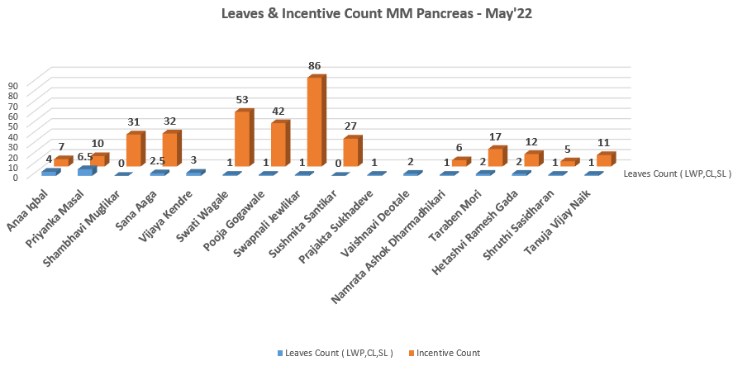
Leave & Incentive Count
MM Pancreas

Slide 14
Thanks

